Slide 1
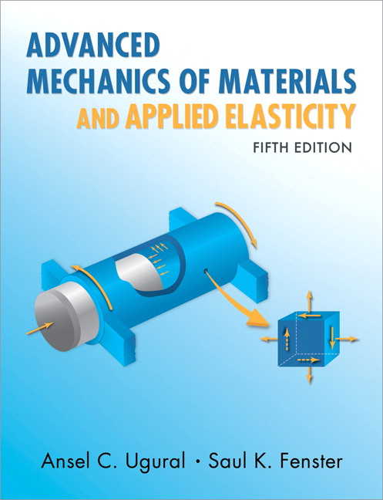
Advanced Mechanics
(Lecture 22)
ANNOUNCE / BUSINESS
Exam 3: Thursday, Apr. 3rd.
No HW due this week
Work on Practice Problems!
PREVIOUS
Energy methods - Reciprocity
TODAY
Energy methods

Slide 2
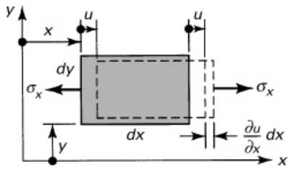
Strain Energy
Work done in deformation is stored in an elastic body
In an ideal elastic process, energy is restored upon unloading, as with an ideal spring
Consider the work done in uniaxial tension of a rectangular prism.
$$U_{o}=\int{dU_{o}}=\int_{0}^{ε_{x}}{σ_{x}dε_{x}}$$
(U_{o} is strain energy density, or strain energy per unit volume)

Slide 3
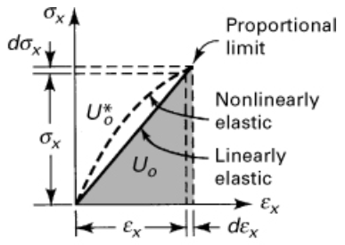
Strain Energy
For a linear elastic material under uniaxial loading, it is the area under the curve
$$U_{o}=\int_{0}^{ε_{x}}{{Eε}_{x}dε_{x}}=\frac{1}{2}Eε_{x}^{2}={{\frac{1}{2}σ}_{x}ε}_{x}=\frac{1}{2E}σ_{x}^{2}$$
(area above curve: complementary energy $U_{o}^{∗}$)
3D:
$$U_{o}={{\frac{1}{2}(σ}_{x}ε}_{x}+{σ_{y}ε}_{y}+{σ_{z}ε}_{z})$$
(stresses in one direction produce deformations in others, but they do no work)

Slide 4
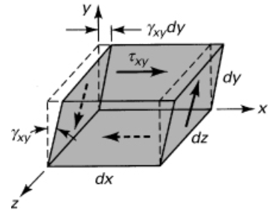
Strain Energy
Definition for strain energy density with shear is analogous
$$U_{o}=\int{dU_{o}}=\int_{0}^{γ_{xy}}{τ_{xy}dγ_{xy}}=\frac{1}{2}Gγ_{xy}^{2}={{\frac{1}{2}τ}_{xy}γ}_{xy}=\frac{1}{2G}τ_{xy}^{2}$$
$$U_{o}={{\frac{1}{2}(τ}_{xy}γ}_{xy}+{τ_{yz}γ}_{yz}+{τ_{xz}γ}_{xz})$$
In general, then,
$$U_{o}={{\frac{1}{2}(σ}_{x}ε}_{x}+{σ_{y}ε}_{y}+{σ_{z}ε}_{z}+{{ τ}_{xy}γ}_{xy}+{τ_{yz}γ}_{yz}+{τ_{xz}γ}_{xz})$$

Slide 5
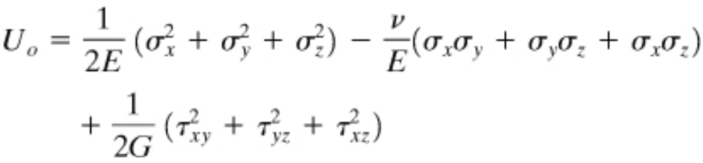
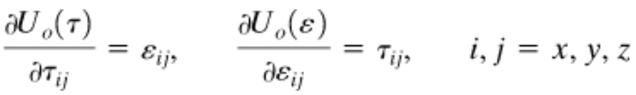
Strain Energy
Introducing Hooke’s Law,
OR
And note that
(* $τ$ is used here to represent general stress, not just shear stress)

Slide 6
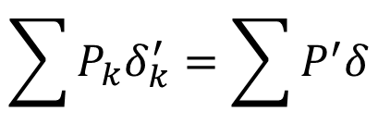
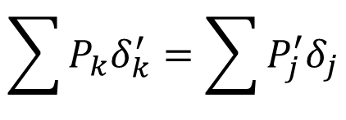
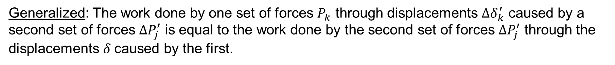

Reciprocity Theorem
The work done by one force $P$ through the displacement $∆δ$ caused by a second force $∆P$ is equal to the work done by the second force $∆P$ through the displacement $δ$caused by the first.
$$P∆δ=∆Pδ$$
Generalized: The work done by one set of forces $P_{k}$ through displacements $∆δ_{k}^{′}$ caused by a second set of forces $∆P_{j}^{′}$ is equal to the work done by the second set of forces $∆P_{j}^{′}$ through the displacements $δ$caused by the first.
$$\sum{P_{k}δ_{k}^{′}}=\sum{P_{j}^{′}δ_{j}}$$
$$\sum{P_{k}δ_{k}^{′}}=\sum{P^{′}δ}$$
For our purposes:

Slide 7


Castigliano’s Theorem
Derived approach to solve for deflections; can similarly find the slope at a point of interest (as long as a couple $C$ is applied there)

Slide 8
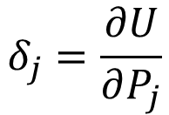
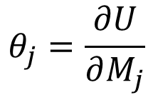
Castigliano’s (Second) Theorem
Linear displacement is equal to the first partial derivative of the strain energy in the body with respect to a force acting at the point and in the direction of displacement
$$δ_{j}=\frac{∂U}{∂P_{j}}$$
Angular displacement is equal to the first partial derivative of the strain energy in the body with respect to a couple moment acting at the point and in the direction of the angular displacement.
$$θ_{j}=\frac{∂U}{∂M_{j}}$$

Slide 9








Strain Energy
$$M$$
$$N$$
$$T$$
$$V$$
Application in common loading scenarios
Axial loading
Bending
Shear (we’ll come back to this)
Torsion
(prismatic; uniform load)

Slide 10

Castigliano’s Theorem
Derived approach to solve for deflections; can similarly find the slope at a point of interest (as long as a couple $C$ is applied there)
Strain energy is a function of axial load, moment, transverse load, and torque, all of which are functions of $P$
Since $P_{i}$ and $C_{i}$ are not functions of $x$, can move the derivative inside the integrals and use product rule:

Slide 11
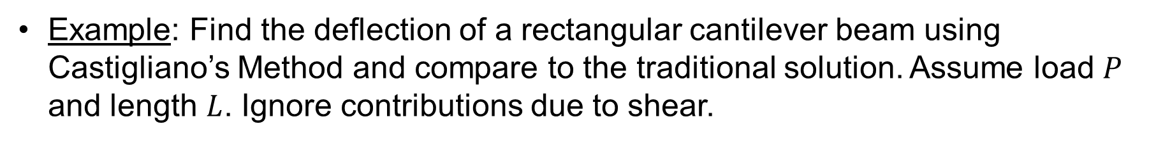
Castigliano’s Theorem
Example: Find the deflection of a rectangular cantilever beam using Castigliano’s Method and compare to the traditional solution. Assume load $P$ and length $L$. Ignore contributions due to shear.

Slide 13



Castigliano’s Theorem
Why did we ignore contributions due to shear?
Referring to Section 5.12 of text, recall that strain energy density due to shear can be expressed as
So strain energy is (Eq’n. 5.64)
Let . Then,

Slide 14

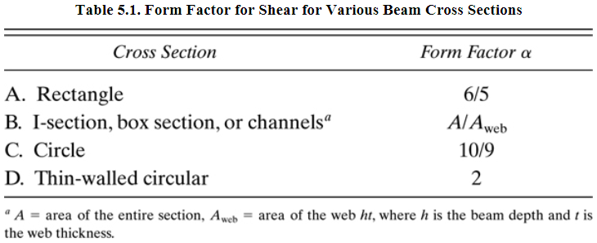
Castigliano’s Theorem
For a rectangular beam,
For other common shapes,

Slide 15


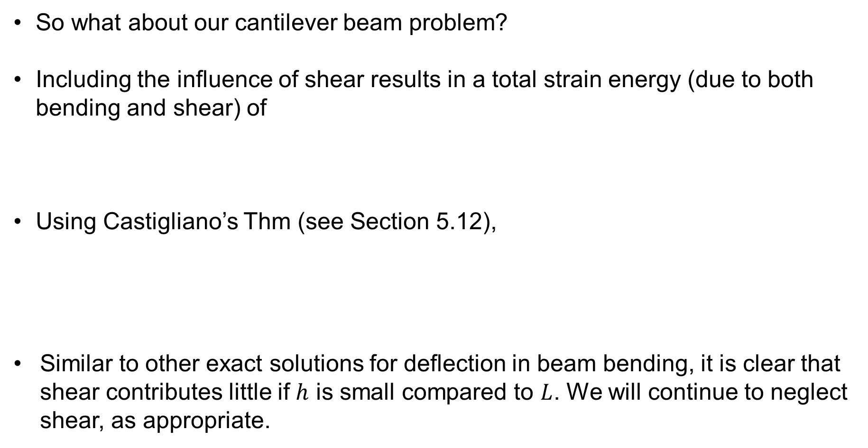

Castigliano’s Theorem
So what about our cantilever beam problem?
Including the influence of shear results in a total strain energy (due to both bending and shear) of
Using Castigliano’s Thm (see Section 5.12),
Similar to other exact solutions for deflection in beam bending, it is clear that shear contributes little if $h$ is small compared to $L$. We will continue to neglect shear, as appropriate.
(where $l=L$)

Slide 16
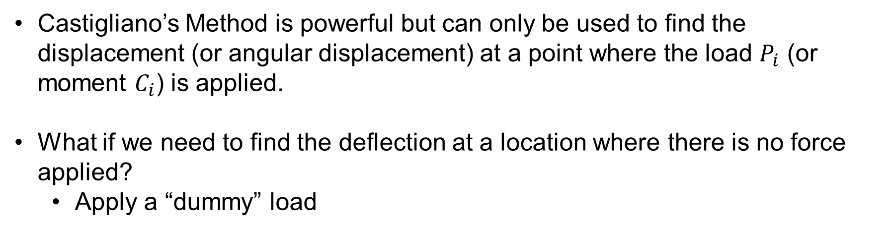
Dummy Loads
Castigliano’s Method is powerful but can only be used to find the displacement (or angular displacement) at a point where the load $P_{i}$ (or moment $C_{i}$) is applied.
What if we need to find the deflection at a location where there is no force applied?
Apply a “dummy” load

Slide 17
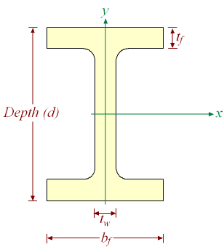



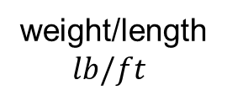

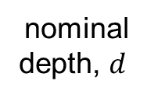


Dummy Loads
Example: Find deflection at $D$ in a beam with a wide-flange ($W10x15$) cross-section. Use $E=29x{10}^{6} psi$ and $I_{x}=69.9 {in}^{4}$.
nominal
depth, $d$
weight/length
$lb/ft$
$$ω=1.8 kip/ft$$
$$A$$
$$B$$
$$D$$
$$7.5’$$
$$12’$$

Slide 20
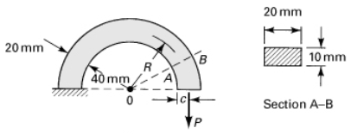
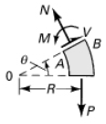
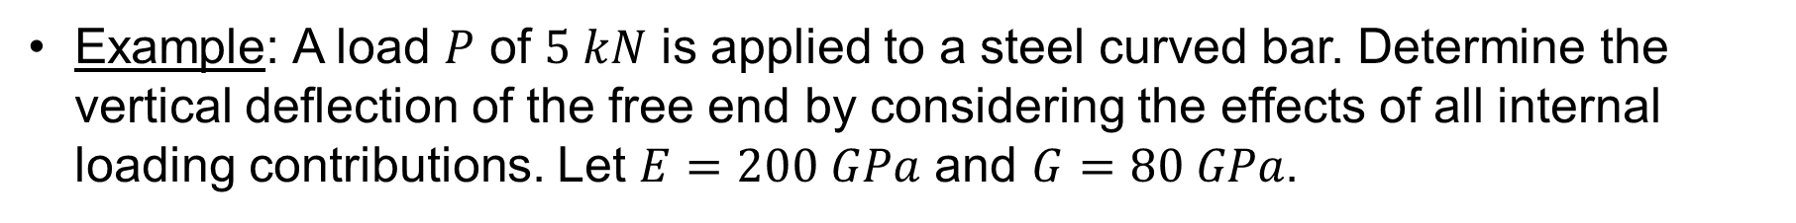
Castigliano’s Theorem
Example: A load $P$ of $5 kN$ is applied to a steel curved bar. Determine the vertical deflection of the free end by considering the effects of all internal loading contributions. Let $E=200 GPa$ and $G=80 GPa$.

